Slide 1
Sprint #1 Review
Team 26
Vivian Chang | Crystal Chen | Lansing(Yifan）Chen

Slide 2
Agenda
Project Background
Website Structure & Functionality
Planned VS. Completed
Problems & Risks
Next Sprint

Slide 3
Project Background
Ingredient Management/ Recipe Search Website

Slide 4
Pain Points
Do not know what to make with a handful of ingredients
Forget what ingredients we have
Starting with a small scope, but has potential to expand in the future (not for this project)
Focus on coffee recipes for now, but could eventually incorporate food recipe
Allow users to enter ingredients instead of picking from drop down menu

Slide 5
Main Functions
Sprint #1:
Basic Setup (Project Structure, DB, Login, Register…)
Function One: Manage Ingredients
Sprint #2:
Function Two: Search Recipe
Function Three: Find Store Near Me

Slide 6
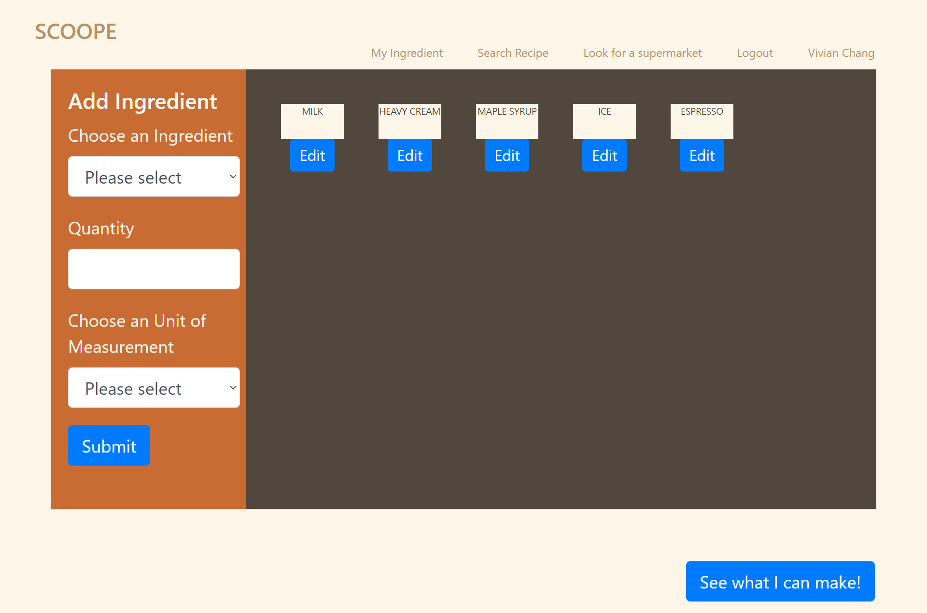

Slide 7
Main Functions
Sprint #1:
Basic Setup (Project Structure, DB, Login, Register…)
Function One: Manage Ingredients
Sprint #2:
Function Two: Search Recipe
Function Three: Find Store Near Me

Slide 8
Website Mockup

Slide 9
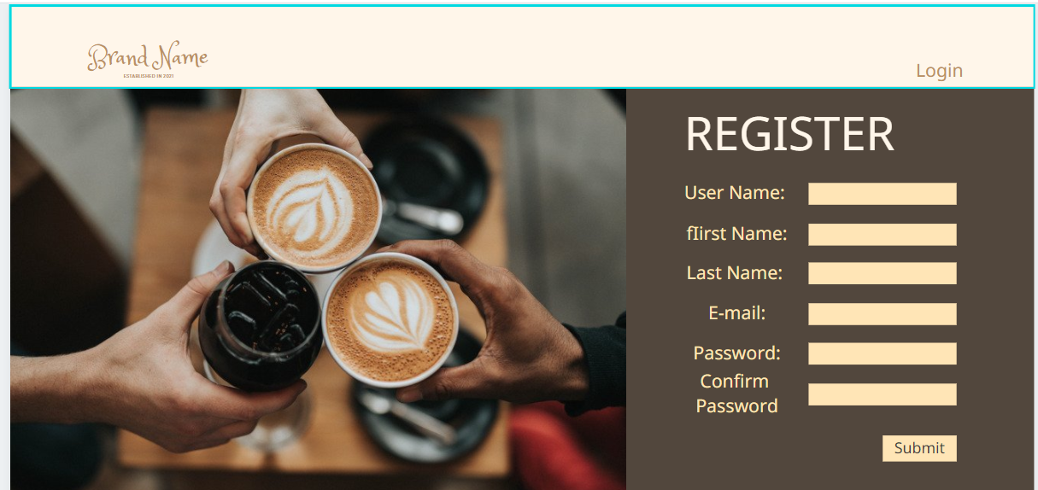


Slide 10
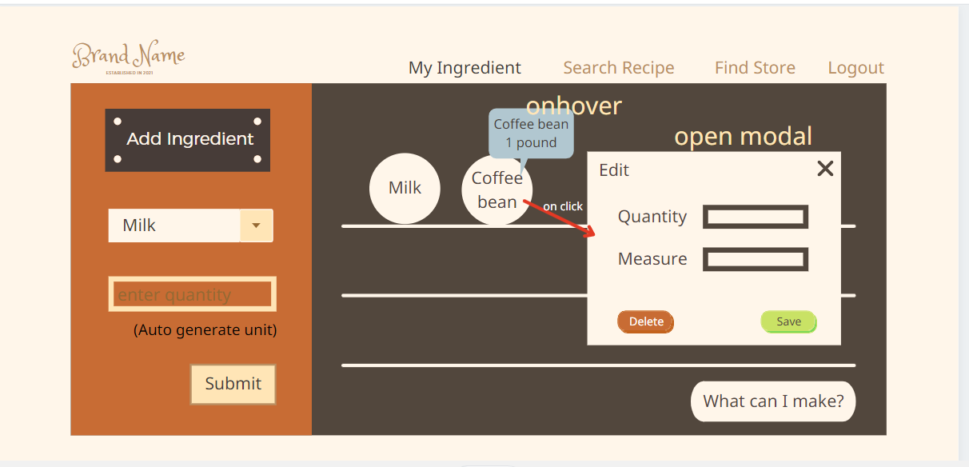

Slide 11
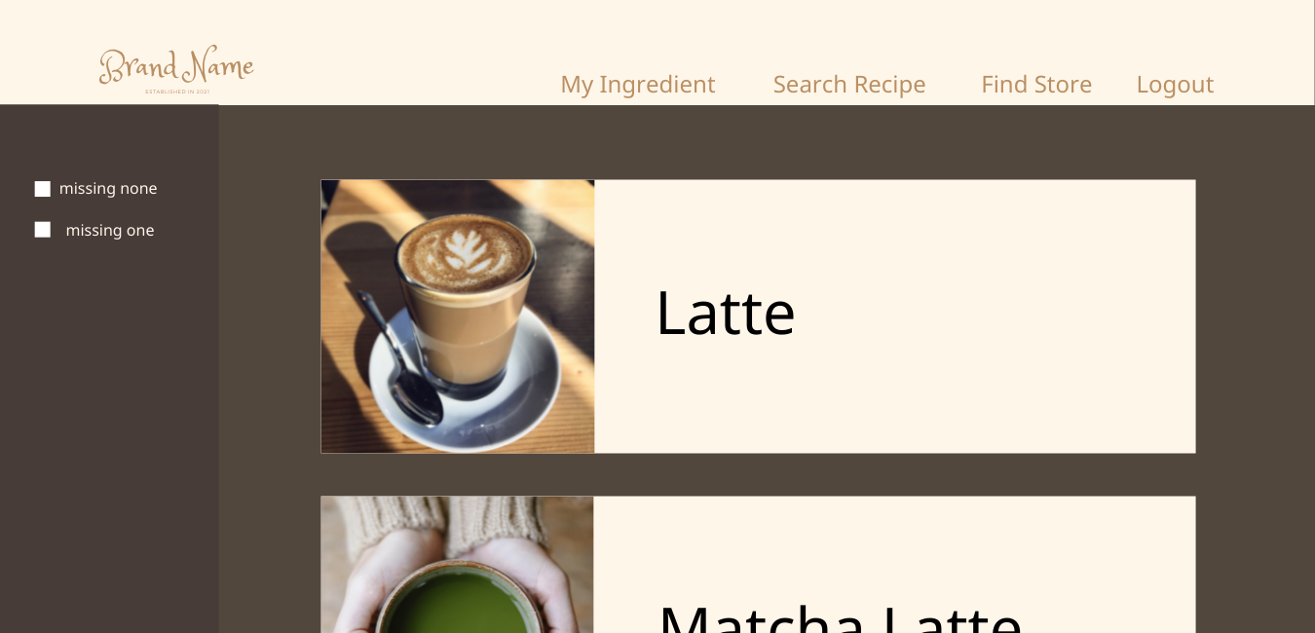

Slide 12
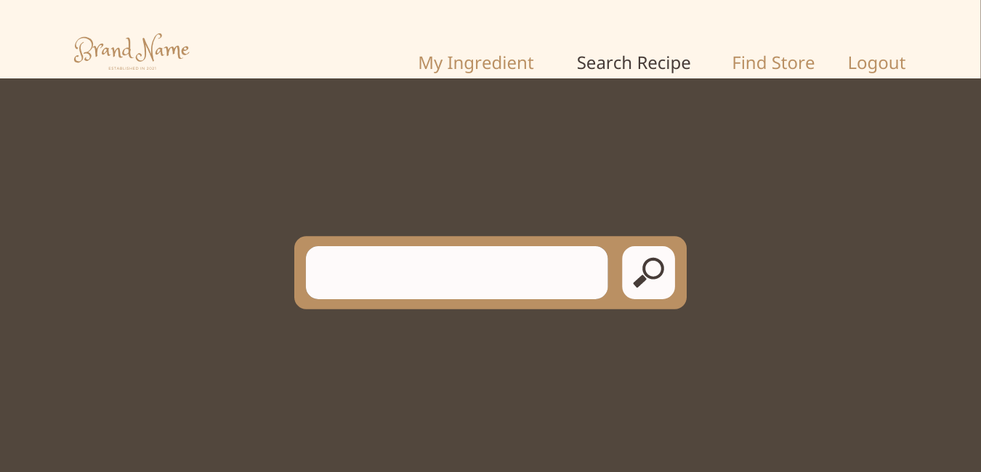
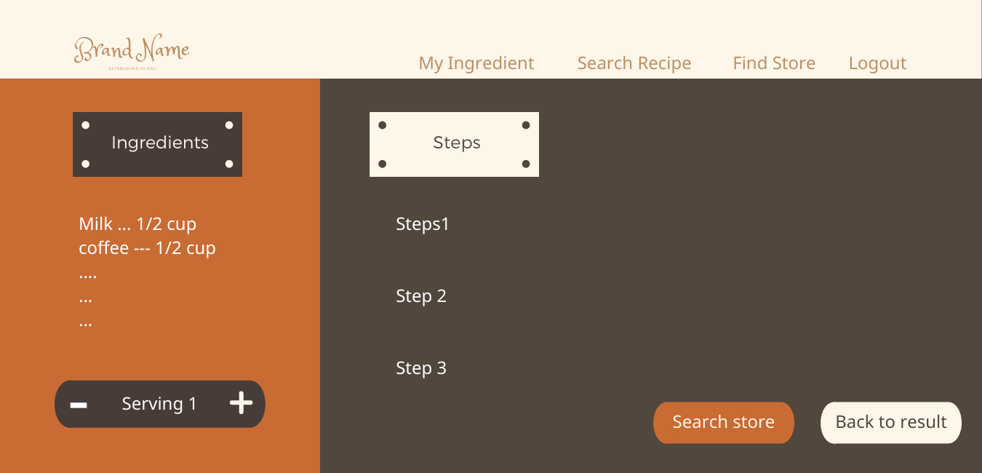

Slide 13


Slide 14
Current Progress
Notes:
Crystal has introduced the original functionality and design plan for our website. Now let’s see what we have completed in sprint 1.

Slide 15
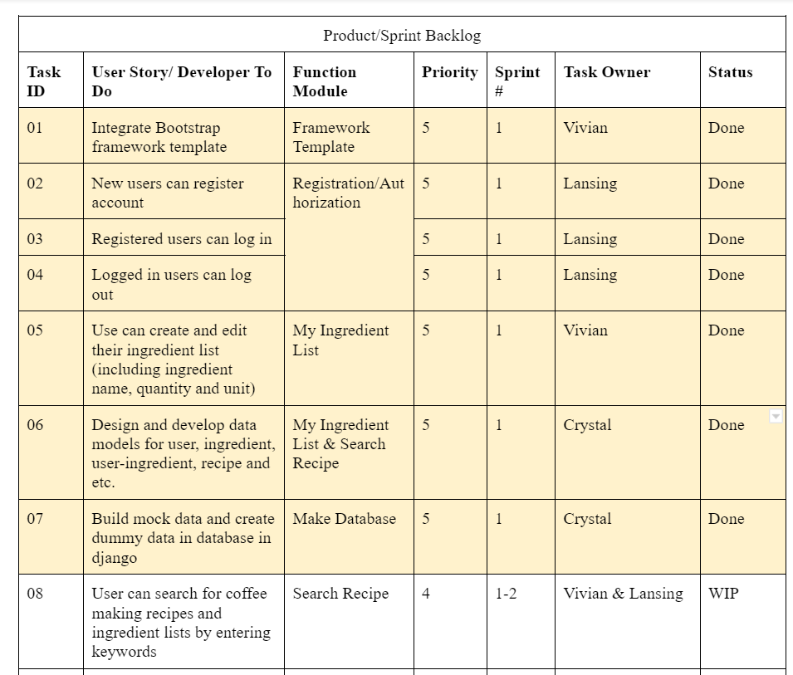
Notes:
The progress for sprint 1 is on the track for now. Most tasks are completed except the search function is working in progress. For now, users can register, log in and log out of our website. The logged in user can add, edit and delete their own ingredient list. From there, they can view recipes results based on their own ingredient list. Let’s try out.

Slide 16
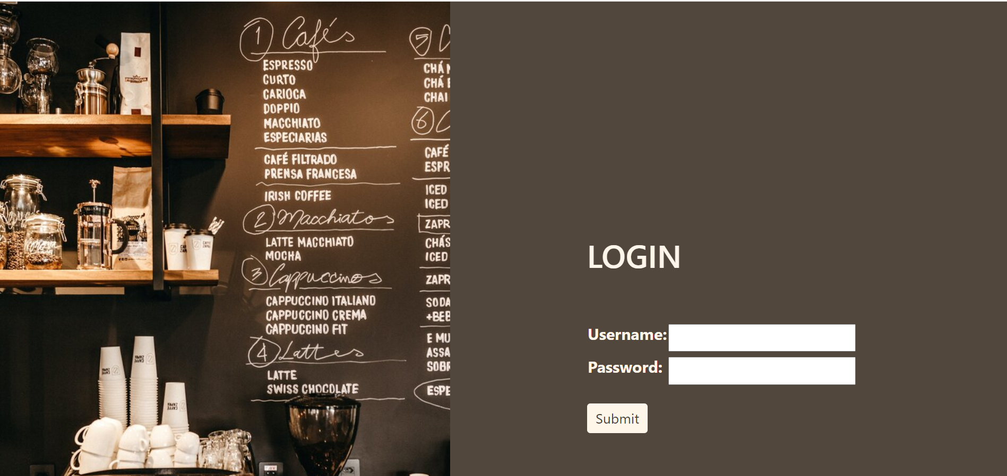
Website Demo
Notes:
Logged in user
Let’s add a new ingredient
Hover to remind the users of the quantity entered last time
If the quantity needs to be updated, the user can click to s

Slide 17
Problems & Risks
Problems Encountered
Data cleaning
Missing info for required data fields from original scraped data
Used dummy data for sprint 1 to build up the structure
Inconsistent local database among developers
Main functions more time consuming than expected
Risk points
External API dependency
Call the Youtube API to fetch related videos
Call the Google Map API to pin and display nearby markets

Slide 18
Next Sprint

Slide 19
Goals for Sprint 2
1. Complete the “See what can I make” function
2. Complete the “Where to buy” function
3. Retrieve more recipes through web scraping and save into database
4. Develop and optimize HTML pages for the website
5. Attempt on good to have functions: display relevant YouTube video links
7. Test
8. Refine code
6. Web Deployment on AWS
Notes:
1. Complete the “See what can I make” function
displaying recipes and coffee making steps based on the user’s current ingredients list
2. Complete the “Where to buy” function
Enable users to view nearby supermarkets in a map to purchase missing ingredients
3. Attempt on good to have functions:
Call Youtube API to fetch links of videos related to makings coffee searched by user
4. Web Deployment
Deploy the website on AWS ec2 machines
5.

